Slide 1
Advances in Cryptography
Workshop Cyber Situational Awareness

Slide 2
Cryptography Process
Original
Message
Process
Secret
Message
Alice
Bob
Eve

Slide 3
Properties of Good Cryptography
Avalanche Effect
Completeness
No Collision
Deterministic

Slide 4
Process
Transposition
Substitution
Lookup Table
Arithmetic and Logic

Slide 5
MAP Level 1
Cryptography
Not Using Key
Using SEPARATE Key
Using Message as Key
Steganography

Slide 6
Map Level 2
Not Using Key
Classic, Ex. Caesar
Using SEPARATE Key
Symmetric Key, Ex. DES, AES
Asymmetric Key, Ex. RSA, DSA
USING MESSAGE as Key
Hash, Ex. MD5, SHA1

Slide 7
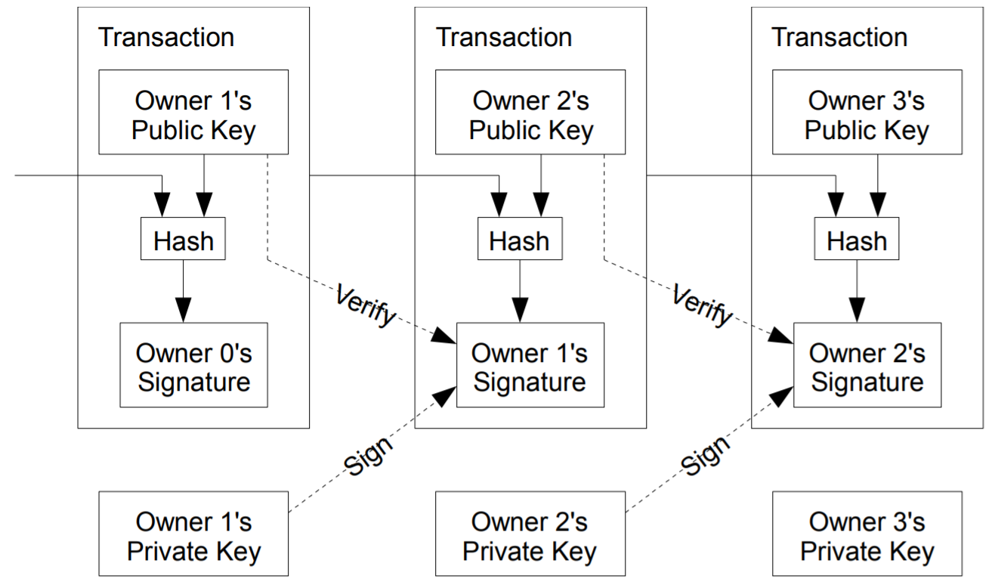
BlockChain

Slide 8
Terima Kasih

